Slide 1
Electronic Instrumentation Section-1, Ppt-7

Slide 2
Digital Storage Oscilloscope (DSO)

Slide 3
Definition: The digital storage oscilloscope is defined as the oscilloscope which stores and analysis the signal digitally, i.e. in the form of 1 or 0 .

Slide 4
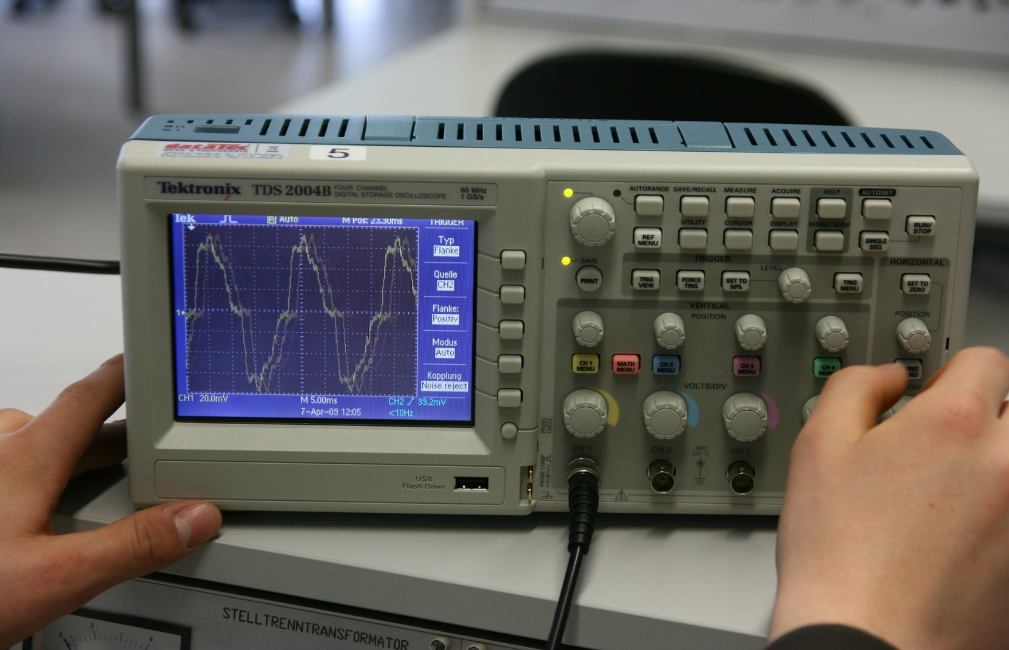
In the 1980s, the company Nicolet Test Instrument created the first digital storage oscilloscope (DSO) using a relatively slow (1 MHz) analog-to-digital converter (ADC).

Slide 5
Probe: The oscilloscope needs a way to measure the voltage between two points in your circuit under test. Most probes have two tips that you attach to different nodes in your circuit.
Amplifier/Attenuator: Most oscilloscopes have circuits that amplify or attenuate captured electrical signals so they can be effectively displayed to the user and to avoid damaging components inside the oscilloscope.
Trigger Select: Many modern oscilloscopes allow you to chose between an internal or external signal (from a separate source) to trigger the display of the waveform.
Control Logic: Logic or software that allows a user to configure how signals are captured and displayed. The control logic is similar to the horizontal controls found on the analog oscilloscope but often offers more options

Slide 6
ADC: The analog-to-digital converter samples the electrical signal from the test circuit at regular intervals as set by the control logic. These samples are converted to binary numbers that are stored in memory.
Memory: Digital information representing the sampled signal is stored in memory. This information is used to reconstruct a close approximation to the original electrical signal on the display in graph format.
Time Base: As set by the control logic, the time base controls the horizontal axis on the display. The user can set one or more trigger points to adjust the time base to capture sporadic signals or hold periodic signals, like sine waves, steady in the display.
Display: The oscilloscope takes data from memory, combines it with information from the time base, and displays a waveform on the screen. Often, this waveform will be a close representation of the originally sampled signal with voltage as the Y-axis and time as the X-axis. Some older digital oscilloscopes use CRTs as displays whereas most modern DSOs rely on LCDs.

Slide 7
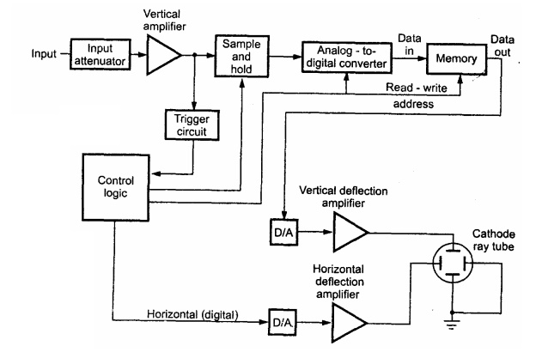

Slide 8
The input signal is applied to the amplifier and attenuator section.
The oscilloscope uses same type of amplifier and attenuator circuitry as used in the conventional oscilloscopes.
The attenuated signal is then applied to the vertical amplifier.

Slide 9
Sample and Hold Circuit
The Sample and Hold circuit is an electronic circuit which creates the samples of voltage given to it as input, and after that, it holds these samples for the definite time.
The time during which sample and hold circuit generates the sample of the input signal is called sampling time.
Similarly, the time duration of the circuit during which it holds the sampled value is called holding time.

Slide 10
Need of Sample and Hold Circuit
The main and important advantage of a typical SH Circuit is to aid an Analog to Digital Conversion process by holding the sampled analog input voltage.
In multichannel ADCs, where synchronization between different channels is important, an SH circuit can help by sampling analog signals from all the channels at the same time.
In multiplexed circuits, the crosstalk can be reduced with an SH circuit.

Slide 11
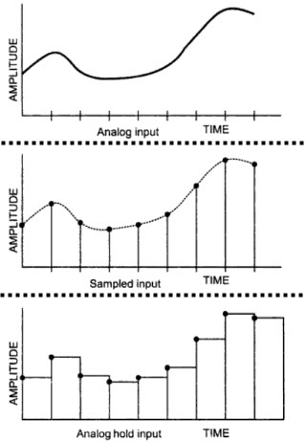
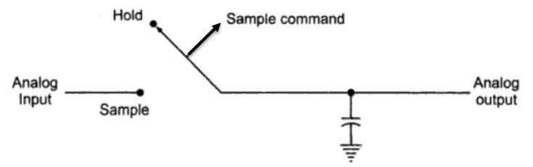

Slide 12
To digitize the analog signal, analog to digital (A/D) converter is used.
The output of the vertical amplifier is applied to the A/D converter section.
The successive approximation type of A/D converter is most oftenly used in
the digital storage oscilloscopes.
The sampling rate and memory size are selected depending upon the duration & the waveform to be recorded.
Once the input signal is sampled, the A/D converter digitizes it.
The signal is then captured in the memory.
Once it is stored in the memory, many manipulations are possible as memory can be readout without being erased.

Slide 13
In a digital storage oscilloscope, there are three modes of operation. They are as follows: • Store • Roll • Hold or Save.

Slide 14
Advantage of DSO
i) It is easier to operate and has more capability.
ii) The storage time is infinite.
iii) The display flexibility is available. The number of traces that can be stored and recalled depends on the size of the memory.
iv) The cursor measurement is possible.
v) The characters can be displayed on screen along with the waveform which can indicate waveform information such as minimum, maximum, frequency, amplitude etc.
vi) The X-Y plots, B-H curve, P-V diagrams can be displayed.

Slide 15
What is the main advantage of using a digital storage oscilloscope? a) uses digital storage b) uses Analog storage c) uses mixed mode storage d) uses disc storage

Slide 16
The waveform is stored in _________ a) compressed form b) analog form c) digital form d) mixed form

Slide 17
The stored image can be displayed _________ a) for a limited time b) for infinite time c) for zero time d) for an intermediate time

Slide 18
The analog signal is digitized using _________ a) D/A converter b) Oscillator c) A/D converter d) Rectifier

Slide 19
A digital storage oscilloscope has _________ a) 3 modes b) 2 modes c) 4 modes d) 5 modes

Slide 20
Thank you

